Slide 1
Cyprus: Environmental Issues and Challenges
Cultural Foundation 1948 – Elias Kania

Slide 2
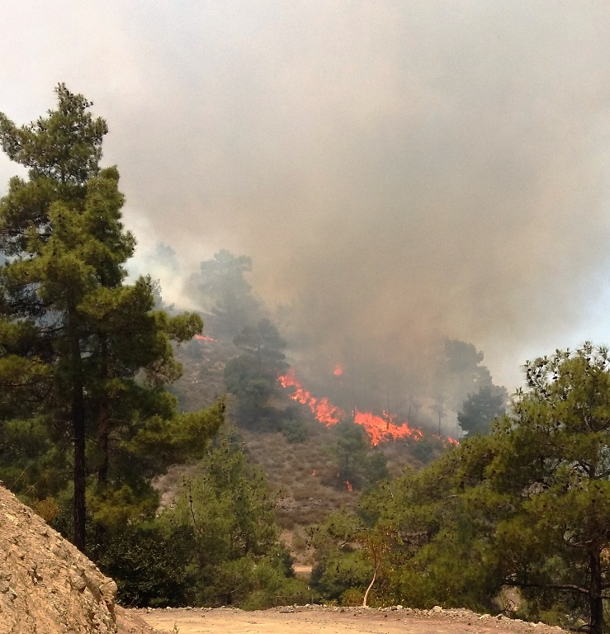
Intense Wildfires
Climate change, and as a cause, weather change, make our forests prone and vulnerable to fires.
According to studies and expert forecasts, this situation is due to climate change and the warming that our planet is experiencing, causing the meteorological conditions on our island with the prolonged hot and dry summers and strong winds.
Climate change is causing more drought, higher temperatures and periods of stronger winds, especially in southern European countries, including Cyprus.
According to data from the Department of Forestry, in the period 2000-2019 a total of 2,221 hectares of land were burned (average of the period) whereas in contrast only in 2021 a total of 6,612 hectares of land were burned.

Slide 3
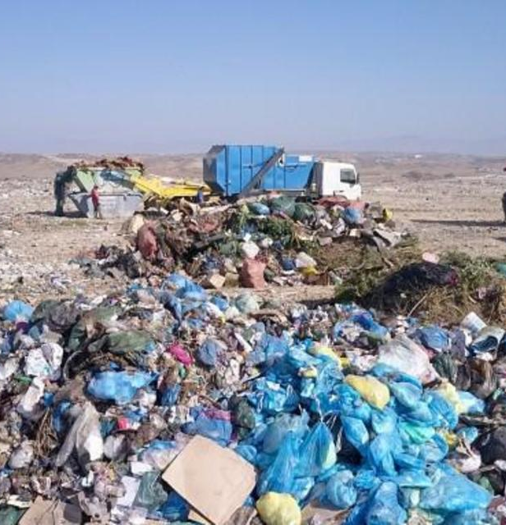
Waste and Illegal Dumping
In Cyprus there are a number of illegal dumping sites all around the island.
In Cyprus, according to the national waste management plan, the costs for waste management range between 50-125 Euro per house per year, in a country of 300K households
The local government promised to organize a large programme, between 2022-2025, to coordinate with local communities and municipalities, to detect illegal dumping and arrange cleaning operations.
Waste management is a huge problem in European Union. According to Eurostat, each citizen generates 492 kilos of waste per year (figure below, left). Most of this waste ends up eventually at landfills, without being reused/recycled, especially at the countries of south and central Europe

Slide 4
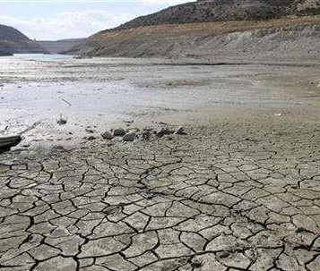
Prolonged Drought
Climate change is exacerbating drought in many parts of the world, increasing its frequency, severity and duration which causes risks for agriculture and food security in Cyprus
Irrigated agriculture consumes approximately 70% of the available water, the Mediterranean basin is considered one of the most vulnerable areas to climate change, while Cyprus is expected to be much more affected in the coming decades.
A study carried out recently for Cyprus concluded that climate variability, high temperatures and limited precipitation restrict crop production in Cyprus. It was shown that annual crop yields in Cyprus were reduced by 41%- 43% for 2013‐2020 compared to 1980‐2009.
The projected warming in the period 2031-2060 compared with 1971-2000, mostly in spring and summer, might expose the crops to conditions likely to have an adverse impact on the phenological stages of the plants, which, as a consequence, may affect the plants’ production and crop quality. The crops of potatoes, wheat and tomato may be negatively affected from the warming projected.

Slide 5
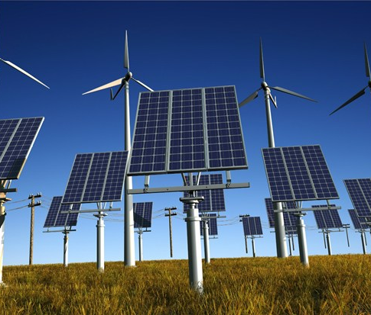
Energy sources
In the context of Cyprus, the country right now struggles to meet the goals in regard to the penetration of renewables to the total production of energy. According to GreenMatch, Cyprus has the highest rate of greenhouse gas (GHG) emissions per capita, being by far the worst performing country in Europe.
Cyprus met the target of 13% energy use by 2020 with RES penetration, but achieved only 14.9% by the end of 2021. It is to be noted that this is very low compared to the real needs for meeting the 40% of 2030 and 100% of 2050 RES target of the EU through the revised objectives of the Green Deal
Penetration of renewables to the Cyprus market is still very low, also our electricity utility cannot absorb more renewable generation, due to its old system
Currently about 25% of roofs are covered by PV leaving 75% uncovered. Cyprus is dependent on oil imported from other countries, a fact that not only significantly affects the economic prospects and long-term financial wealth of the country, but also it is a bad solution that heavily pollutes the environment.
Recently, the Republic of Cyprus realized that this is also a bad practice from political perspectives. Cyprus has around 273 days of sunshine per year (75%), with sunshine hours ranging from 171 hours in January up to 397 hours in July. There is a large potential for the use of photovoltaics massively across the country. Cyprus is destined to cover its energy needs via renewable energy.

Slide 6
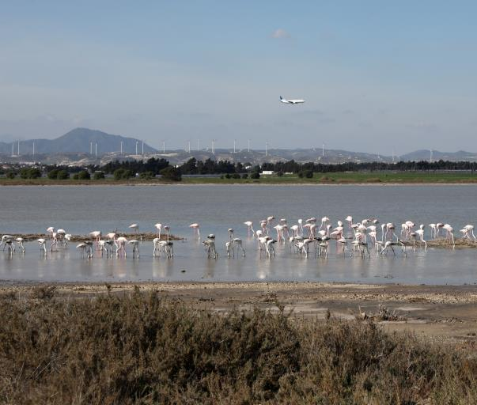
Biodiversity loss
The Mediterranean ecohydrology is vulnerable to climate change, and can affect flora and fauna of the region. In arid and semi-arid parts of the region, the biggest danger facing the lakes is the expected decrease in water input resulting from increasing evapotranspiration with increasing temperature and decreasing precipitation. This process can lead to conversion of existing freshwater to saltwater.
Serious threats to the biodiversity of the Island can be considered the effects of climate change, land use change, invasive species, illegal hunting, and forest fires.
One of the main threats to biodiversity is the development currently taking place in Cyprus, with hotels, luxury apartment complexes, villas and golf courses that are being built in natural areas, destroying and/or altering important habitats mainly by the coastal areas.
Water shortage and long droughts have always characterised Cyprus. Sediments from rivers no longer reached the coast due to the numerous dams, with consequence the decreased rate of the sediment deposition to result in the loss of beachfront.

